Slide 1

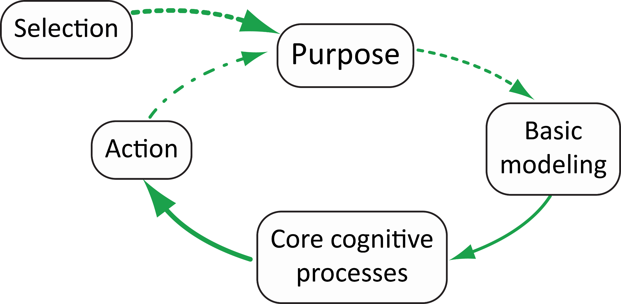
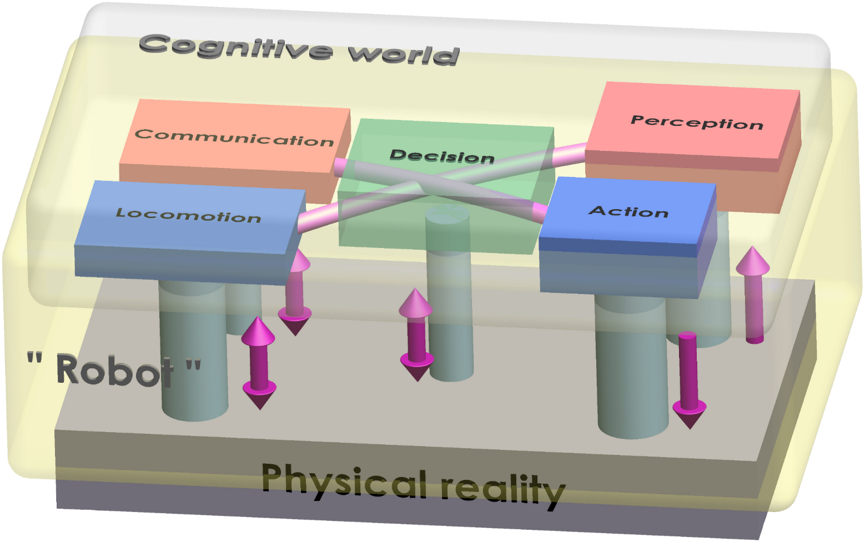
SGAICO Annual Assembly and Workshop
Deep Learning and Beyond
Nov. 16, 2016 - Hochschule Luzern Informatik -
Campus Zug-Rotkreuz, Switzerland
Cognition Squeezed Between Nature and Values
Cognition (via modeling)
Action for survival and changing the world | Cognition (per se) for planning and steering action | Emotion for synchronization with reality* for launching action**
"Muscle", physical engine | "Brain", cognitive engine | "Heart", Indicator of values at stake (threats and opportunities)
physical world, Laws of nature; true | cognitive world , "non-physical", Laws of logic; right | mixed mode, ("meta-logic") emotional domain; Laws of value ; good
* immersed part of iceberg (unconscious) ** visible part of iceberg; re. etymology of emotion
Tex Avery
For cognition, it all starts from value-based selection of appropriate goal, in synchrony with nature (i.e. from emotion)
Cognition in the context of action (re. nature) and emotion (re. values) – Some typical aspects for humans and societies, agents and groups
Action | Cognition | Emotion
support operations, logistics | follows & optimizes rules, guidelines, standards; computes; evolution; syntax | changes rules and paradigms; irrationality, deception; changes price, gives and takes; revolution; peace or war
Motor and brake operation | cruise control (re. gear, throttle targets) | tempomat adjustment and braking control; starts-stops
force, energy; fight or flee; control power, | notions of truth, c-goodness, imagination, if-worlds, modeling, prediction | internal monitoring, communication, wisdom, consciousness, empathy, solidarity, dignity, mercy
shepherd's dog, horse | shepherd, shepherdess | lamb, flock of sheep, Romulus's & Remus's lupa
executive power (Cesar, MT) | Legislative power, science | People initiatives, fashion, strikes, mobs
lion, bear, bull | think tank, re. Martians in "Mars attacks" | flock of birds; "federative" imperial dragon (camel head, etc.)
technology, engineering | philosophy, "analytic" philosophy | religion, "continental" philosophy
work, operation | rational thinking, meditation, function, administration | strategy, art (value-laden, symbolic communication), dreams and nightmares, relaxation, mindfulness
Mars; permanence (constancy, determination, time) | mixed mode | Venus; change (synchronicity with circumstances and instant values, speed)
soldier, police, fire squad, farmer, entrepreneur, sports - individual | school, research institute, science, admin., games of strategy (logic), chess | ambassador, mediator, court system, social services, insurance, banking, sports-team
Examples of smart cognitive systems, operational in real world
neutral,
more general
man-made,
"artificial"
"natural",
anthropomorphical
References.:
J.-D. Dessimoz, HESSO.HEIG-VD, 2nd Int. Conf. on Natural Cognition, 10-11 Dec. 2015, Macao
Kobu's Fyrabeseminar, 05.02.2016, Bern
Cours RAC, HEIG-VD, Yverdon-les-Bains, Juin 2016
Robotics and Automated Systems-Elsevier, nov. 2016, http://dx.doi.org/10.1016/j.robot.2016.08.008
Jean-Daniel Dessimoz – Yverdon-les-Bains, Switzerland
HEIG-VD, School of Business and Engineering
HES-SO, Western Switzerland University of Applied Sciences and Arts
jean-daniel.dessimoz@heig-vd.ch http://lara.populus.org/rub/3

